Slide 1

COVID-19 Vaccination Data Website
Jason Chu
Scott Mesdjian
Brayan Montiel
Mahamadsaad Sheikh
Hongan Zhang

Slide 2
Agenda
1
Overview of Dataset and Features
2
Live Demo
3
Major Design Walkthrough
4
Q & A

Slide 3
Overview of Dataset
California COVID-19 Vaccination Data website
Breaks down vaccination trends by various demographic categories
Visualize different vaccination analytics through charts and tables
Technologies utilized
Framework: Django
Front End: HTML, CSS, Javascript
Backend: Python, JSON
Data Source
California Health & Human Services Open Data - https://data.chhs.ca.gov/dataset/vaccine-progress-dashboard
Notes:
45 seconds

Slide 4
App Features
Search Records by Demographics
Age group, Gender, Race/Ethnicity
ID Number
Date Administered
Update/Modify Records
Edits existing records in dataset
Insert Records
Adds new records onto live dataset
Delete Records
Deletes existing records in dataset
Backup/Import Records
Backs up live dataset to JSON master file
Imports dataset
Notes:
45 seconds

Slide 5

Demo
Notes:
4-5 min max if possible

Slide 6

Major Design
(main fields/functions for app features)
Parsing:
results(request)
Modifying:
delete_record(request)
insert_record(request)
modify_record(request)
backup_record(request)

Slide 7
Major Design
Analytics
➔ Which vaccine (Moderna, Pfizer, J&J) is the most popular among different races/ethnicities?
➔ Which month were the most/least people vaccinated?
➔ Which demographic (i.e. ethnicity, age, gender) is the most/least vaccinated?
➔ How do different age groups compare regarding vaccination rates?
➔ Which vaccine manufacturer was administered the most?
➔ Which gender is more likely to get their second dose of vaccinations (i.e. become fully vaccinated)?

Slide 8

Major Design
(main fields/functions for analytics)
Analytics:
monthly_vaccination_analytics(request)
race_vaccine_analytics(request)
mfpiechart(request)
fully_vaccinated_analytics(request)
ageGroup(request)
Incremental analysis:
increment_gender(request)
increment_ageGroup(request)

Slide 9
Major Design
Improvements
Performance of Analytics
Incremental analytics: Less Time Consumed
Incremental analytics: Less Memory Consumption
Time & Space complexity analysis
Planned/Completed Features and Polishing
CSS/HTML interactive UI
Neat results in tabular format
Improve clicking response on analytical graphs
Additional fields for insertion

Slide 10
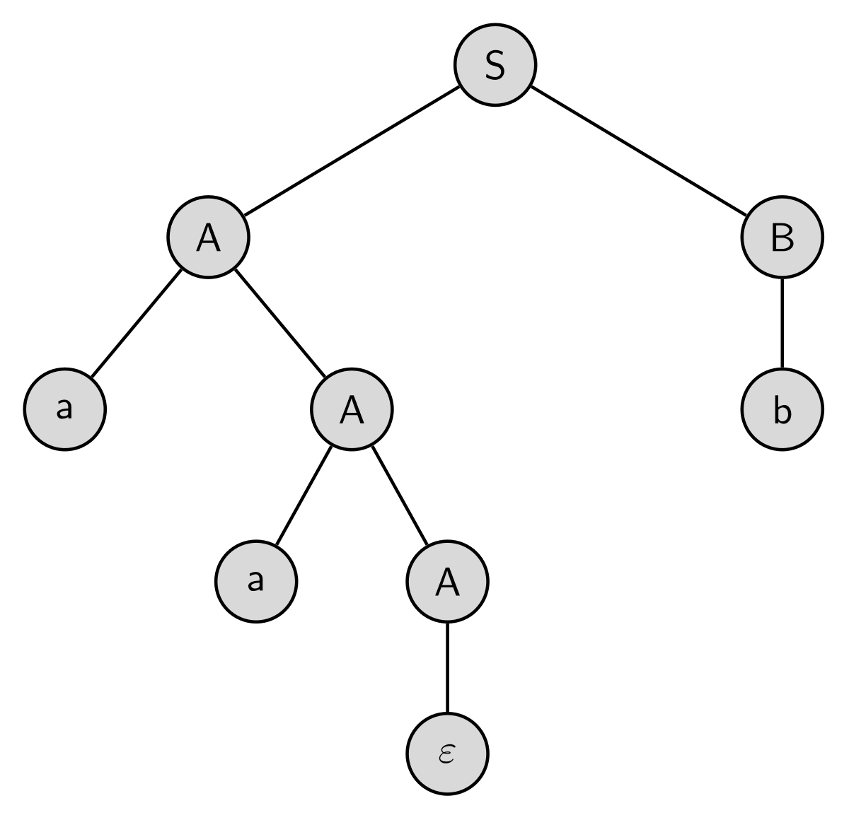


Major Design
Project Challenges
Reflecting Changes in Analytics
Data Parsing
Front/Backend
01
Updating changes in our graphs when doing modifications, insertions or deletions
Familiarizing how to use JSON to fetch data in an organized fashion
Diving deep into new frameworks and UI

Slide 11

Notes:
45 seconds

